Slide 1
Nonlinear data visualization
林思涵
2023/06/27

Slide 2
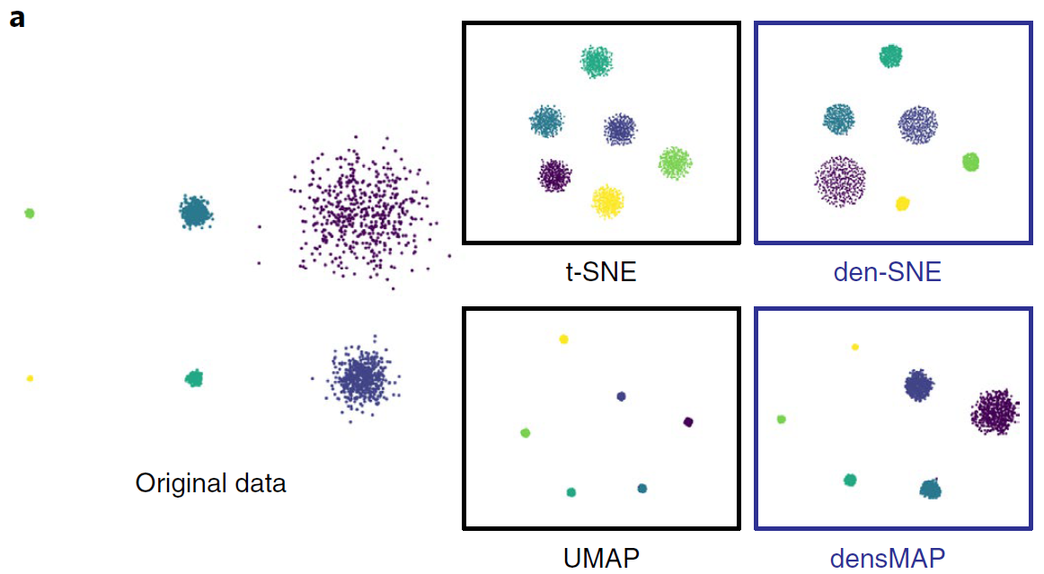
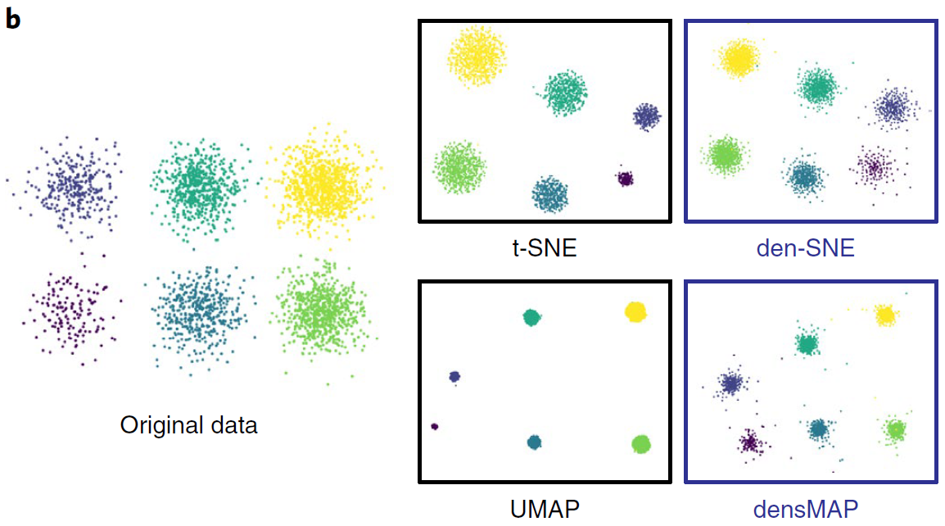
每個組別的個數不相同，但散佈程度相同
每組散佈程度跟組內個數成正比
每個組別的個數相同，但散佈程度不同
每組散佈程度皆相同
Well-known Visualization | add Density-preserving
t-SNE Maaten and Hinton (2008)(36387) Maaten(2014)(2583) | den-SNE Narayan et al. (2021)(61)
UMAP McInnes et al. (2018)(8458) | densMAP

Slide 3
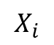
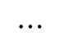
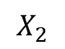
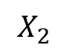
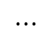
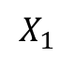
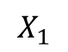
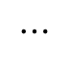
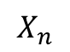
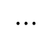
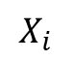
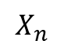
t-SNE
UMAP
$$X_{1}$$
$$X_{2}$$
$$⋯$$
$$X_{i}$$
$$⋯$$
$$X_{n}$$
$$X_{1}$$
$$X_{2}$$
$$⋯$$
$$X_{i}$$
$$⋯$$
$$X_{n}$$

Slide 4
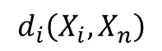
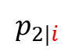
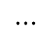
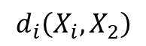
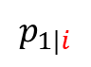
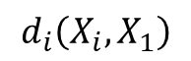
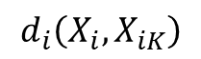
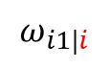
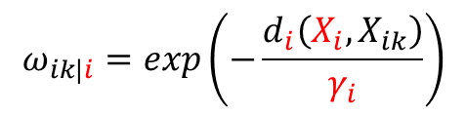
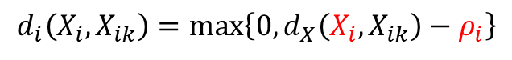
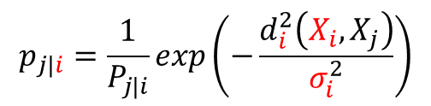
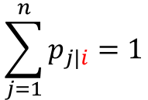
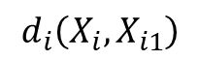
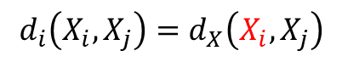
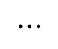
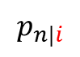
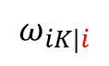
t-SNE
UMAP
$$X_{1}$$
$$X_{2}$$
$$⋯$$
$$X_{i}$$
$$⋯$$
$$X_{n}$$
$$X_{1}$$
$$X_{2}$$
$$⋯$$
$$X_{i}$$
$$⋯$$
$$X_{n}$$
pairwise
K-NN
$$d_{i}\left(X_{i},X_{j}\right)=d_{X}\left(X_{i},X_{j}\right)$$
$$d_{i}\left(X_{i},X_{ik}\right)=\max_{}\left\{0,d_{X}\left(X_{i},X_{ik}\right)−ρ_{i}\right\}$$
$$d_{i}\left(X_{i},X_{1}\right)$$
$$d_{i}\left(X_{i},X_{2}\right)$$
$$⋯$$
$$d_{i}\left(X_{i},X_{n}\right)$$
$$d_{i}\left(X_{i},X_{i1}\right)$$
$$⋯$$
$$d_{i}\left(X_{i},X_{iK}\right)$$
$$p_{j|i}=\frac{1}{P_{j|i}}exp\left(−\frac{d_{i}^{2}\left(X_{i},X_{j}\right)}{σ_{i}^{2}}\right)$$
$$ω_{ik|i}=exp\left(−\frac{d_{i}\left(X_{i},X_{ik}\right)}{γ_{i}}\right)$$
$$p_{1|i}$$
$$p_{2|i}$$
$$p_{n|i}$$
$$ω_{i1|i}$$
$$ω_{iK|i}$$
$$\sum_{j=1}^{n}{p_{j|i}}=1$$

Slide 5
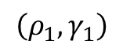
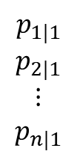
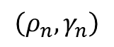
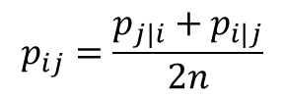
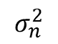
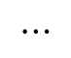
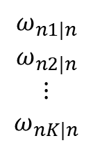
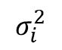
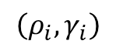
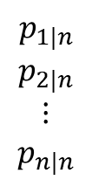
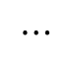
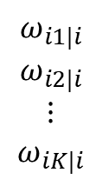
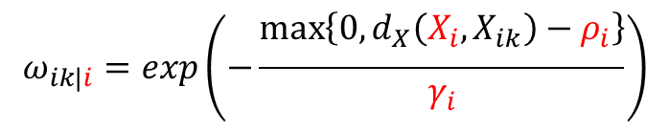
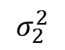
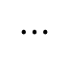
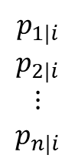
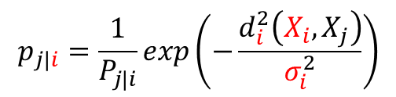
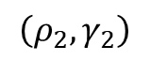
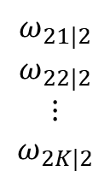





$$p_{j|i}=\frac{1}{P_{j|i}}exp\left(−\frac{d_{i}^{2}\left(X_{i},X_{j}\right)}{σ_{i}^{2}}\right)$$
$$ω_{ik|i}=exp\left(−\frac{\max_{}\left\{0,d_{X}\left(X_{i},X_{ik}\right)−ρ_{i}\right\}}{γ_{i}}\right)$$
t-SNE
UMAP
$$X_{1}$$
$$X_{2}$$
$$⋯$$
$$X_{i}$$
$$⋯$$
$$X_{n}$$
$$X_{1}$$
$$X_{2}$$
$$⋯$$
$$X_{i}$$
$$⋯$$
$$X_{n}$$
$$σ_{1}^{2}$$
$$σ_{2}^{2}$$
$$⋯$$
$$σ_{i}^{2}$$
$$⋯$$
$$σ_{n}^{2}$$
$$\left(ρ_{1},γ_{1}\right)$$
$$\left(ρ_{2},γ_{2}\right)$$
$$⋯$$
$$\left(ρ_{i},γ_{i}\right)$$
$$⋯$$
$$\left(ρ_{n},γ_{n}\right)$$
$$p_{1|1}$$
$$p_{2|1}$$
$$⋮$$
$$p_{n|1}$$
$$p_{1|2}$$
$$p_{2|2}$$
$$⋮$$
$$p_{n|2}$$
$$p_{1|i}$$
$$p_{2|i}$$
$$⋮$$
$$p_{n|i}$$
$$p_{1|n}$$
$$p_{2|n}$$
$$⋮$$
$$p_{n|n}$$
$$ω_{11|1}$$
$$ω_{12|1}$$
$$⋮$$
$$ω_{1K|1}$$
$$ω_{21|2}$$
$$ω_{22|2}$$
$$⋮$$
$$ω_{2K|2}$$
$$ω_{i1|i}$$
$$ω_{i2|i}$$
$$⋮$$
$$ω_{iK|i}$$
$$ω_{n1|n}$$
$$ω_{n2|n}$$
$$⋮$$
$$ω_{nK|n}$$
$$p_{ij}=\frac{p_{j|i}+p_{i|j}}{2n}$$
$$ω_{ij}=ω_{j|i}+ω_{i|j}−ω_{j|i}∙ω_{i|j}$$

Slide 6













$$p_{j|i}=\frac{1}{P_{j|i}}exp\left(−\frac{d_{X}^{2}\left(X_{i},X_{j}\right)}{σ_{i}^{2}}\right)$$
$$ω_{ik|i}=exp\left(−\frac{\max_{}\left\{0,d_{X}\left(X_{i},X_{ik}\right)−ρ_{i}\right\}}{γ_{i}}\right)$$
t-SNE
UMAP
$$X_{1}$$
$$X_{2}$$
$$⋯$$
$$X_{i}$$
$$⋯$$
$$X_{n}$$
$$X_{1}$$
$$X_{2}$$
$$⋯$$
$$X_{i}$$
$$⋯$$
$$X_{n}$$
$$σ_{1}^{2}$$
$$σ_{2}^{2}$$
$$⋯$$
$$σ_{i}^{2}$$
$$⋯$$
$$σ_{n}^{2}$$
$$\left(ρ_{1},γ_{1}\right)$$
$$\left(ρ_{2},γ_{2}\right)$$
$$⋯$$
$$\left(ρ_{i},γ_{i}\right)$$
$$⋯$$
$$\left(ρ_{n},γ_{n}\right)$$
$$p_{1|1}$$
$$p_{2|1}$$
$$⋮$$
$$p_{n|1}$$
$$p_{1|2}$$
$$p_{2|2}$$
$$⋮$$
$$p_{n|2}$$
$$p_{1|i}$$
$$p_{2|i}$$
$$⋮$$
$$p_{n|i}$$
$$p_{1|n}$$
$$p_{2|n}$$
$$⋮$$
$$p_{n|n}$$
$$ω_{11|1}$$
$$ω_{12|1}$$
$$⋮$$
$$ω_{1K|1}$$
$$ω_{21|2}$$
$$ω_{22|2}$$
$$⋮$$
$$ω_{2K|2}$$
$$ω_{i1|i}$$
$$ω_{i2|i}$$
$$⋮$$
$$ω_{iK|i}$$
$$ω_{n1|n}$$
$$ω_{n2|n}$$
$$⋮$$
$$ω_{nK|n}$$
$$p_{ij}=\frac{p_{j|i}+p_{i|j}}{2n}$$
$$ω_{ij}=ω_{j|i}+ω_{i|j}−ω_{j|i}∙ω_{i|j}$$
$$Y_{1}$$
$$Y_{2}$$
$$⋯$$
$$Y_{i}$$
$$⋯$$
$$Y_{n}$$
$$Y_{1}$$
$$Y_{2}$$
$$⋯$$
$$Y_{i}$$
$$⋯$$
$$Y_{n}$$

Slide 7






$$p_{j|i}=\frac{1}{P_{j|i}}exp\left(−\frac{d_{X}^{2}\left(X_{i},X_{j}\right)}{σ_{i}^{2}}\right)$$
$$ω_{ik|i}=exp\left(−\frac{\max_{}\left\{0,d_{X}\left(X_{i},X_{ik}\right)−ρ_{i}\right\}}{γ_{i}}\right)$$
t-SNE
UMAP
$$X_{1}$$
$$X_{2}$$
$$⋯$$
$$X_{i}$$
$$⋯$$
$$X_{n}$$
$$X_{1}$$
$$X_{2}$$
$$⋯$$
$$X_{i}$$
$$⋯$$
$$X_{n}$$
$$σ_{1}^{2}$$
$$σ_{2}^{2}$$
$$⋯$$
$$σ_{i}^{2}$$
$$⋯$$
$$σ_{n}^{2}$$
$$\left(ρ_{1},γ_{1}\right)$$
$$\left(ρ_{2},γ_{2}\right)$$
$$⋯$$
$$\left(ρ_{i},γ_{i}\right)$$
$$⋯$$
$$\left(ρ_{n},γ_{n}\right)$$
$$p_{1|1}$$
$$p_{2|1}$$
$$⋮$$
$$p_{n|1}$$
$$p_{1|2}$$
$$p_{2|2}$$
$$⋮$$
$$p_{n|2}$$
$$p_{1|i}$$
$$p_{2|i}$$
$$⋮$$
$$p_{n|i}$$
$$p_{1|n}$$
$$p_{2|n}$$
$$⋮$$
$$p_{n|n}$$
$$ω_{11|1}$$
$$ω_{12|1}$$
$$⋮$$
$$ω_{1K|1}$$
$$ω_{21|2}$$
$$ω_{22|2}$$
$$⋮$$
$$ω_{2K|2}$$
$$ω_{i1|i}$$
$$ω_{i2|i}$$
$$⋮$$
$$ω_{iK|i}$$
$$ω_{n1|n}$$
$$ω_{n2|n}$$
$$⋮$$
$$ω_{nK|n}$$
$$p_{ij}=\frac{p_{j|i}+p_{i|j}}{2n}$$
$$ω_{ij}=ω_{j|i}+ω_{i|j}−ω_{j|i}∙ω_{i|j}$$
$$∈\left[0,1\right]$$
讓$p_{ij}$跟$q_{ij}$接近
讓$ω_{ij}$跟$Φ\left(Y_{i},Y_{j}\right)$接近
min KL divergence
min Cross entropy
$$q_{ij}=\frac{1}{Q}{\left(1+a{\left\|Y_{i}−Y_{j}\right\|}_{2}^{2b}\right)}^{−1}$$
$$Φ\left(Y_{i},Y_{j}\right)={\left(1+a{\left\|Y_{i}−Y_{j}\right\|}_{2}^{2b}\right)}^{−1}$$
$$∈\left[0,1\right]$$
$$Y_{1}$$
$$Y_{2}$$
$$⋯$$
$$Y_{i}$$
$$⋯$$
$$Y_{n}$$
$$Y_{1}$$
$$Y_{2}$$
$$⋯$$
$$Y_{i}$$
$$⋯$$
$$Y_{n}$$

Slide 8
$$p_{j|i}=\frac{1}{P_{j|i}}exp\left(−\frac{d_{X}^{2}\left(X_{i},X_{j}\right)}{σ_{i}^{2}}\right)$$
$$ω_{ik|i}=exp\left(−\frac{\max_{}\left\{0,d_{X}\left(X_{i},X_{ik}\right)−ρ_{i}\right\}}{γ_{i}}\right)$$
t-SNE
UMAP
$$X_{1}$$
$$X_{2}$$
$$⋯$$
$$X_{i}$$
$$⋯$$
$$X_{n}$$
$$X_{1}$$
$$X_{2}$$
$$⋯$$
$$X_{i}$$
$$⋯$$
$$X_{n}$$
$$σ_{1}^{2}$$
$$σ_{2}^{2}$$
$$⋯$$
$$σ_{i}^{2}$$
$$⋯$$
$$σ_{n}^{2}$$
$$\left(ρ_{1},γ_{1}\right)$$
$$\left(ρ_{2},γ_{2}\right)$$
$$⋯$$
$$\left(ρ_{i},γ_{i}\right)$$
$$⋯$$
$$\left(ρ_{n},γ_{n}\right)$$
大家一樣嗎
$$p_{1|1}$$
$$p_{2|1}$$
$$⋮$$
$$p_{n|1}$$
$$p_{1|2}$$
$$p_{2|2}$$
$$⋮$$
$$p_{n|2}$$
$$p_{1|i}$$
$$p_{2|i}$$
$$⋮$$
$$p_{n|i}$$
$$p_{1|n}$$
$$p_{2|n}$$
$$⋮$$
$$p_{n|n}$$
$$ω_{11|1}$$
$$ω_{12|1}$$
$$⋮$$
$$ω_{1K|1}$$
$$ω_{21|2}$$
$$ω_{22|2}$$
$$⋮$$
$$ω_{2K|2}$$
$$ω_{i1|i}$$
$$ω_{i2|i}$$
$$⋮$$
$$ω_{iK|i}$$
$$ω_{n1|n}$$
$$ω_{n2|n}$$
$$⋮$$
$$ω_{nK|n}$$
?
$$p_{ij}=\frac{p_{j|i}+p_{i|j}}{2n}$$
$$ω_{ij}=ω_{j|i}+ω_{i|j}−ω_{j|i}∙ω_{i|j}$$
$$∈\left[0,1\right]$$
讓$p_{ij}$跟$q_{ij}$接近
讓$ω_{ij}$跟$Φ\left(Y_{i},Y_{j}\right)$接近
min KL divergence
min Cross entropy
大家都一樣
$$q_{ij}=\frac{1}{Q}{\left(1+a{\left\|Y_{i}−Y_{j}\right\|}_{2}^{2b}\right)}^{−1}$$
$$Φ\left(Y_{i},Y_{j}\right)={\left(1+a{\left\|Y_{i}−Y_{j}\right\|}_{2}^{2b}\right)}^{−1}$$
$$∈\left[0,1\right]$$
$$Y_{1}$$
$$Y_{2}$$
$$⋯$$
$$Y_{i}$$
$$⋯$$
$$Y_{n}$$
$$Y_{1}$$
$$Y_{2}$$
$$⋯$$
$$Y_{i}$$
$$⋯$$
$$Y_{n}$$

Slide 9
$$p_{j|i}=\frac{1}{P_{j|i}}exp\left(−\frac{d_{X}^{2}\left(X_{i},X_{j}\right)}{σ_{i}^{2}}\right)$$
$$ω_{ik|i}=exp\left(−\frac{\max_{}\left\{0,d_{X}\left(X_{i},X_{ik}\right)−ρ_{i}\right\}}{γ_{i}}\right)$$
t-SNE
UMAP
$$X_{1}$$
$$X_{2}$$
$$⋯$$
$$X_{i}$$
$$⋯$$
$$X_{n}$$
$$X_{1}$$
$$X_{2}$$
$$⋯$$
$$X_{i}$$
$$⋯$$
$$X_{n}$$
$$σ_{1}^{2}$$
$$σ_{2}^{2}$$
$$⋯$$
$$σ_{i}^{2}$$
$$⋯$$
$$σ_{n}^{2}$$
$$\left(ρ_{1},γ_{1}\right)$$
$$\left(ρ_{2},γ_{2}\right)$$
$$⋯$$
$$\left(ρ_{i},γ_{i}\right)$$
$$⋯$$
$$\left(ρ_{n},γ_{n}\right)$$
讓大家變一樣
$$p_{1|1}$$
$$p_{2|1}$$
$$⋮$$
$$p_{n|1}$$
$$p_{1|2}$$
$$p_{2|2}$$
$$⋮$$
$$p_{n|2}$$
$$p_{1|i}$$
$$p_{2|i}$$
$$⋮$$
$$p_{n|i}$$
$$p_{1|n}$$
$$p_{2|n}$$
$$⋮$$
$$p_{n|n}$$
$$ω_{11|1}$$
$$ω_{12|1}$$
$$⋮$$
$$ω_{1K|1}$$
$$ω_{21|2}$$
$$ω_{22|2}$$
$$⋮$$
$$ω_{2K|2}$$
$$ω_{i1|i}$$
$$ω_{i2|i}$$
$$⋮$$
$$ω_{iK|i}$$
$$ω_{n1|n}$$
$$ω_{n2|n}$$
$$⋮$$
$$ω_{nK|n}$$
$$p_{ij}=\frac{p_{j|i}+p_{i|j}}{2n}$$
$$ω_{ij}=ω_{j|i}+ω_{i|j}−ω_{j|i}∙ω_{i|j}$$
讓$p_{ij}$跟$q_{ij}$接近
讓$ω_{ij}$跟$Φ\left(Y_{i},Y_{j}\right)$接近
min KL divergence
min Cross entropy
大家都一樣
$$q_{ij}=\frac{1}{Q}{\left(1+a{\left\|Y_{i}−Y_{j}\right\|}_{2}^{2b}\right)}^{−1}$$
$$Φ\left(Y_{i},Y_{j}\right)={\left(1+a{\left\|Y_{i}−Y_{j}\right\|}_{2}^{2b}\right)}^{−1}$$
$$Y_{1}$$
$$Y_{2}$$
$$⋯$$
$$Y_{i}$$
$$⋯$$
$$Y_{n}$$
$$Y_{1}$$
$$Y_{2}$$
$$⋯$$
$$Y_{i}$$
$$⋯$$
$$Y_{n}$$

Slide 10





$$p_{j|i}=\frac{1}{P_{j|i}}exp\left(−\frac{d_{X}^{2}\left(X_{i},X_{j}\right)}{σ_{i}^{2}}\right)$$
$$ω_{ik|i}=exp\left(−\frac{\max_{}\left\{0,d_{X}\left(X_{i},X_{ik}\right)−ρ_{i}\right\}}{γ_{i}}\right)$$
t-SNE
UMAP
$$X_{1}$$
$$X_{2}$$
$$⋯$$
$$X_{i}$$
$$⋯$$
$$X_{n}$$
$$X_{1}$$
$$X_{2}$$
$$⋯$$
$$X_{i}$$
$$⋯$$
$$X_{n}$$
$$σ_{1}^{2}$$
$$σ_{2}^{2}$$
$$⋯$$
$$σ_{i}^{2}$$
$$⋯$$
$$σ_{n}^{2}$$
$$\left(ρ_{1},γ_{1}\right)$$
$$\left(ρ_{2},γ_{2}\right)$$
$$⋯$$
$$\left(ρ_{i},γ_{i}\right)$$
$$⋯$$
$$\left(ρ_{n},γ_{n}\right)$$
讓大家變一樣
$$p_{1|1}$$
$$p_{2|1}$$
$$⋮$$
$$p_{n|1}$$
$$p_{1|2}$$
$$p_{2|2}$$
$$⋮$$
$$p_{n|2}$$
$$p_{1|i}$$
$$p_{2|i}$$
$$⋮$$
$$p_{n|i}$$
$$p_{1|n}$$
$$p_{2|n}$$
$$⋮$$
$$p_{n|n}$$
$$ω_{11|1}$$
$$ω_{12|1}$$
$$⋮$$
$$ω_{1K|1}$$
$$ω_{21|2}$$
$$ω_{22|2}$$
$$⋮$$
$$ω_{2K|2}$$
$$ω_{i1|i}$$
$$ω_{i2|i}$$
$$⋮$$
$$ω_{iK|i}$$
$$ω_{n1|n}$$
$$ω_{n2|n}$$
$$⋮$$
$$ω_{nK|n}$$
$$p_{ij}=\frac{p_{j|i}+p_{i|j}}{2n}$$
$$ω_{ij}=ω_{j|i}+ω_{i|j}−ω_{j|i}∙ω_{i|j}$$
讓$p_{ij}$跟$q_{ij}$接近
讓$ω_{ij}$跟$Φ\left(Y_{i},Y_{j}\right)$接近
min KL divergence
min Cross entropy
大家都一樣
$$q_{ij}=\frac{1}{Q}{\left(1+a{\left\|Y_{i}−Y_{j}\right\|}_{2}^{2b}\right)}^{−1}$$
$$Φ\left(Y_{i},Y_{j}\right)={\left(1+a{\left\|Y_{i}−Y_{j}\right\|}_{2}^{2b}\right)}^{−1}$$
$$Y_{1}$$
$$Y_{2}$$
$$⋯$$
$$Y_{i}$$
$$⋯$$
$$Y_{n}$$
$$Y_{1}$$
$$Y_{2}$$
$$⋯$$
$$Y_{i}$$
$$⋯$$
$$Y_{n}$$

Slide 11










$$p_{j|i}=\frac{1}{P_{j|i}}exp\left(−\frac{d_{X}^{2}\left(X_{i},X_{j}\right)}{σ_{i}^{2}}\right)$$
$$ω_{ik|i}=exp\left(−\frac{\max_{}\left\{0,d_{X}\left(X_{i},X_{ik}\right)−ρ_{i}\right\}}{γ_{i}}\right)$$
t-SNE
UMAP
$$X_{1}$$
$$X_{2}$$
$$⋯$$
$$X_{i}$$
$$⋯$$
$$X_{n}$$
$$X_{1}$$
$$X_{2}$$
$$⋯$$
$$X_{i}$$
$$⋯$$
$$X_{n}$$
$$σ_{1}^{2}$$
$$σ_{2}^{2}$$
$$⋯$$
$$σ_{i}^{2}$$
$$⋯$$
$$σ_{n}^{2}$$
$$\left(ρ_{1},γ_{1}\right)$$
$$\left(ρ_{2},γ_{2}\right)$$
$$⋯$$
$$\left(ρ_{i},γ_{i}\right)$$
$$⋯$$
$$\left(ρ_{n},γ_{n}\right)$$
讓大家變一樣
$$p_{1|1}$$
$$p_{2|1}$$
$$⋮$$
$$p_{n|1}$$
$$p_{1|2}$$
$$p_{2|2}$$
$$⋮$$
$$p_{n|2}$$
$$p_{1|i}$$
$$p_{2|i}$$
$$⋮$$
$$p_{n|i}$$
$$p_{1|n}$$
$$p_{2|n}$$
$$⋮$$
$$p_{n|n}$$
$$ω_{11|1}$$
$$ω_{12|1}$$
$$⋮$$
$$ω_{1K|1}$$
$$ω_{21|2}$$
$$ω_{22|2}$$
$$⋮$$
$$ω_{2K|2}$$
$$ω_{i1|i}$$
$$ω_{i2|i}$$
$$⋮$$
$$ω_{iK|i}$$
$$ω_{n1|n}$$
$$ω_{n2|n}$$
$$⋮$$
$$ω_{nK|n}$$
Perplexity (a fixed value u)
Given a fixed value u
$$P_{i}=\left\{p_{1|i},p_{2|i},⋯,p_{n|i}\right\}$$
$$Prep\left(P_{i}\right)=2^{H\left(P_{i}\right)}$$
$$H\left(P_{i}\right)=−\sum_{j}{p_{j|i}\log_{2}{p_{j|i}}}$$
$$Ω_{i}=\left\{ω_{i1|i},ω_{i2|i},⋯,ω_{iK|i}\right\}$$
$$\sum_{k=1}^{K}{ω_{ik|i}}=\log_{2}{u}$$
$$\log_{2}{u=}\sum_{k=1}^{K}{ω_{1k|1}}=\sum_{k=1}^{K}{ω_{2k|2}}=⋯=\sum_{k=1}^{K}{ω_{nk|n}}$$
find
$\log_{2}{u}=H\left(P_{1}\right)=H\left(P_{2}\right)=⋯=H\left(P_{n}\right)$
find
$$σ_{1}^{2}$$
$$σ_{2}^{2}$$
$$σ_{n}^{2}$$
$$γ_{1}$$
$$γ_{2}$$
$$γ_{n}$$

Slide 12










$$p_{j|i}=\frac{1}{P_{j|i}}exp\left(−\frac{d_{X}^{2}\left(X_{i},X_{j}\right)}{σ_{i}^{2}}\right)$$
$$ω_{ik|i}=exp\left(−\frac{\max_{}\left\{0,d_{X}\left(X_{i},X_{ik}\right)−ρ_{i}\right\}}{γ_{i}}\right)$$
t-SNE
UMAP
$$X_{1}$$
$$X_{2}$$
$$⋯$$
$$X_{i}$$
$$⋯$$
$$X_{n}$$
$$X_{1}$$
$$X_{2}$$
$$⋯$$
$$X_{i}$$
$$⋯$$
$$X_{n}$$
$$σ_{1}^{2}$$
$$σ_{2}^{2}$$
$$⋯$$
$$σ_{i}^{2}$$
$$⋯$$
$$σ_{n}^{2}$$
$$\left(ρ_{1},γ_{1}\right)$$
$$\left(ρ_{2},γ_{2}\right)$$
$$⋯$$
$$\left(ρ_{i},γ_{i}\right)$$
$$⋯$$
$$\left(ρ_{n},γ_{n}\right)$$
讓大家變一樣
$$p_{1|1}$$
$$p_{2|1}$$
$$⋮$$
$$p_{n|1}$$
$$p_{1|2}$$
$$p_{2|2}$$
$$⋮$$
$$p_{n|2}$$
$$p_{1|i}$$
$$p_{2|i}$$
$$⋮$$
$$p_{n|i}$$
$$p_{1|n}$$
$$p_{2|n}$$
$$⋮$$
$$p_{n|n}$$
$$ω_{11|1}$$
$$ω_{12|1}$$
$$⋮$$
$$ω_{1K|1}$$
$$ω_{21|2}$$
$$ω_{22|2}$$
$$⋮$$
$$ω_{2K|2}$$
$$ω_{i1|i}$$
$$ω_{i2|i}$$
$$⋮$$
$$ω_{iK|i}$$
$$ω_{n1|n}$$
$$ω_{n2|n}$$
$$⋮$$
$$ω_{nK|n}$$
Perplexity (a fixed value u)
Given a fixed value u
$$P_{i}=\left\{p_{1|i},p_{2|i},⋯,p_{n|i}\right\}$$
$$Prep\left(P_{i}\right)=2^{H\left(P_{i}\right)}$$
$$H\left(P_{i}\right)=−\sum_{j}{p_{j|i}\log_{2}{p_{j|i}}}$$
$$Ω_{i}=\left\{ω_{i1|i},ω_{i2|i},⋯,ω_{iK|i}\right\}$$
$$\sum_{k=1}^{K}{ω_{ik|i}}=\log_{2}{u}$$
$$\log_{2}{u}=\sum_{k=1}^{K}{ω_{1k|1}}=\sum_{k=1}^{K}{ω_{2k|2}}=⋯=\sum_{k=1}^{K}{ω_{nk|n}}$$
find
$\log_{2}{u}=H\left(P_{1}\right)=H\left(P_{2}\right)=⋯=H\left(P_{n}\right)$
find
$$σ_{1}^{2}$$
$$σ_{2}^{2}$$
$$σ_{n}^{2}$$
為什麼t-SNE的圓比UMAP大?
$$γ_{1}$$
$$γ_{2}$$
$$γ_{n}$$

Slide 13
$$p_{j|i}=\frac{1}{P_{j|i}}exp\left(−\frac{d_{X}^{2}\left(X_{i},X_{j}\right)}{σ_{i}^{2}}\right)$$
$$ω_{ik|i}=exp\left(−\frac{\max_{}\left\{0,d_{X}\left(X_{i},X_{ik}\right)−ρ_{i}\right\}}{γ_{i}}\right)$$
t-SNE
UMAP
$$X_{1}$$
$$X_{2}$$
$$⋯$$
$$X_{i}$$
$$⋯$$
$$X_{n}$$
$$X_{1}$$
$$X_{2}$$
$$⋯$$
$$X_{i}$$
$$⋯$$
$$X_{n}$$
$$σ_{1}^{2}$$
$$σ_{2}^{2}$$
$$⋯$$
$$σ_{i}^{2}$$
$$⋯$$
$$σ_{n}^{2}$$
$$\left(ρ_{1},γ_{1}\right)$$
$$\left(ρ_{2},γ_{2}\right)$$
$$⋯$$
$$\left(ρ_{i},γ_{i}\right)$$
$$⋯$$
$$\left(ρ_{n},γ_{n}\right)$$
讓大家變一樣
$$p_{1|1}$$
$$p_{2|1}$$
$$⋮$$
$$p_{n|1}$$
$$p_{1|2}$$
$$p_{2|2}$$
$$⋮$$
$$p_{n|2}$$
$$p_{1|i}$$
$$p_{2|i}$$
$$⋮$$
$$p_{n|i}$$
$$p_{1|n}$$
$$p_{2|n}$$
$$⋮$$
$$p_{n|n}$$
$$ω_{11|1}$$
$$ω_{12|1}$$
$$⋮$$
$$ω_{1K|1}$$
$$ω_{21|2}$$
$$ω_{22|2}$$
$$⋮$$
$$ω_{2K|2}$$
$$ω_{i1|i}$$
$$ω_{i2|i}$$
$$⋮$$
$$ω_{iK|i}$$
$$ω_{n1|n}$$
$$ω_{n2|n}$$
$$⋮$$
$$ω_{nK|n}$$
$$p_{ij}=\frac{p_{j|i}+p_{i|j}}{2n}$$
$$ω_{ij}=ω_{j|i}+ω_{i|j}−ω_{j|i}∙ω_{i|j}$$
$$∈\left[0,1\right]$$
讓$p_{ij}$跟$q_{ij}$接近
讓$ω_{ij}$跟$Φ\left(Y_{i},Y_{j}\right)$接近
min KL divergence
min Cross entropy
大家都一樣
$$q_{ij}=\frac{1}{Q}{\left(1+a{\left\|Y_{i}−Y_{j}\right\|}_{2}^{2b}\right)}^{−1}$$
$$Φ\left(Y_{i},Y_{j}\right)={\left(1+a{\left\|Y_{i}−Y_{j}\right\|}_{2}^{2b}\right)}^{−1}$$
$$∈\left[0,1\right]$$
$$Y_{1}$$
$$Y_{2}$$
$$⋯$$
$$Y_{i}$$
$$⋯$$
$$Y_{n}$$
$$Y_{1}$$
$$Y_{2}$$
$$⋯$$
$$Y_{i}$$
$$⋯$$
$$Y_{n}$$

Slide 14






$$p_{j|i}=\frac{1}{P_{j|i}}exp\left(−\frac{d_{X}^{2}\left(X_{i},X_{j}\right)}{σ_{i}^{2}}\right)$$
$$ω_{ik|i}=exp\left(−\frac{\max_{}\left\{0,d_{X}\left(X_{i},X_{ik}\right)−ρ_{i}\right\}}{γ_{i}}\right)$$
t-SNE
UMAP
$$X_{1}$$
$$X_{2}$$
$$⋯$$
$$X_{i}$$
$$⋯$$
$$X_{n}$$
$$X_{1}$$
$$X_{2}$$
$$⋯$$
$$X_{i}$$
$$⋯$$
$$X_{n}$$
$$σ_{1}^{2}$$
$$σ_{2}^{2}$$
$$⋯$$
$$σ_{i}^{2}$$
$$⋯$$
$$σ_{n}^{2}$$
$$\left(ρ_{1},γ_{1}\right)$$
$$\left(ρ_{2},γ_{2}\right)$$
$$⋯$$
$$\left(ρ_{i},γ_{i}\right)$$
$$⋯$$
$$\left(ρ_{n},γ_{n}\right)$$
讓大家變一樣
$$p_{1|1}$$
$$p_{2|1}$$
$$⋮$$
$$p_{n|1}$$
$$p_{1|2}$$
$$p_{2|2}$$
$$⋮$$
$$p_{n|2}$$
$$p_{1|i}$$
$$p_{2|i}$$
$$⋮$$
$$p_{n|i}$$
$$p_{1|n}$$
$$p_{2|n}$$
$$⋮$$
$$p_{n|n}$$
$$ω_{11|1}$$
$$ω_{12|1}$$
$$⋮$$
$$ω_{1K|1}$$
$$ω_{21|2}$$
$$ω_{22|2}$$
$$⋮$$
$$ω_{2K|2}$$
$$ω_{i1|i}$$
$$ω_{i2|i}$$
$$⋮$$
$$ω_{iK|i}$$
$$ω_{n1|n}$$
$$ω_{n2|n}$$
$$⋮$$
$$ω_{nK|n}$$
$$p_{ij}=\frac{p_{j|i}+p_{i|j}}{2n}$$
$$ω_{ij}=ω_{j|i}+ω_{i|j}−ω_{j|i}∙ω_{i|j}$$
$$∈\left[0,1\right]$$
$$Φ\left(Y_{i},Y_{j}\right)={\left(1+a{\left\|Y_{i}−Y_{j}\right\|}_{2}^{2b}\right)}^{−1}$$
$$q_{ij}=\frac{1}{Q}{\left(1+a{\left\|Y_{i}−Y_{j}\right\|}_{2}^{2b}\right)}^{−1}$$
$$∈\left[0,1\right]$$
a and b are chosen by non-linear least squares
fitting against the curve $Ψ:ℝ^{d}×ℝ^{d}→\left[0,1\right]$
$$Q=\sum_{k≠l}{{\left(1+{\left\|Y_{k}−Y_{l}\right\|}_{2}^{2}\right)}^{−1}}$$
大家都一樣
$$Ψ\left(Y_{i},Y_{j}\right)=\left\{\begin{matrix}1 & if{\left\|Y_{i}−Y_{j}\right\|}_{2}≤ρ_{y} \\ exp\left(−\left({\left\|Y_{i}−Y_{j}\right\|}_{2}−ρ_{y}\right)\right) & otherwise\end{matrix}\right.$$
$$Y_{1}$$
$$Y_{2}$$
$$⋯$$
$$Y_{i}$$
$$⋯$$
$$Y_{n}$$
$$Y_{1}$$
$$Y_{2}$$
$$⋯$$
$$Y_{i}$$
$$⋯$$
$$Y_{n}$$

Slide 15

t-SNE v.s. UMAP
 | t-SNE | UMAP
高維度 | $$P_{i}=\left\{p_{1|i},p_{2|i},⋯,p_{n|i}\right\}$$ | $$Ω_{i}=\left\{ω_{i1|i},ω_{i2|i},⋯,ω_{iK|i}\right\}$$ K-NN + Graph
 | $$p_{j|i}=\frac{1}{P_{j|i}}exp\left(−\frac{d_{i}^{2}\left(X_{i},X_{j}\right)}{σ_{i}^{2}}\right)$$ $$\sum_{j=1}^{n}{p_{j|i}}=1$$ | $$ω_{ik|i}=exp\left(−\frac{d_{i}\left(X_{i},X_{ik}\right)}{γ_{i}}\right)$$
視覺化維度 | $$q_{ij}=\frac{1}{Q}{\left(1+a{\left\|Y_{i}−Y_{j}\right\|}_{2}^{2b}\right)}^{−1}$$ $$Q=\sum_{k≠l}{{\left(1+{\left\|Y_{k}−Y_{l}\right\|}_{2}^{2}\right)}^{−1}}$$ | $$Φ\left(Y_{i},Y_{j}\right)={\left(1+a{\left\|Y_{i}−Y_{j}\right\|}_{2}^{2b}\right)}^{−1}$$

Slide 16




t-SNE v.s. UMAP
Locally linear embedding
(LLE)
t-SNE | UMAP
$$P_{i}=\left\{p_{1|i},p_{2|i},⋯,p_{n|i}\right\}$$ | $$Ω_{i}=\left\{ω_{i1|i},ω_{i2|i},⋯,ω_{iK|i}\right\}$$ K-NN + Graph
$$p_{j|i}=\frac{1}{P_{j|i}}exp\left(−\frac{d_{i}^{2}\left(X_{i},X_{j}\right)}{σ_{i}^{2}}\right)$$ $$\sum_{j=1}^{n}{p_{j|i}}=1$$ | $$ω_{ik|i}=exp\left(−\frac{d_{i}\left(X_{i},X_{ik}\right)}{γ_{i}}\right)$$
$$q_{ij}=\frac{1}{Q}{\left(1+a{\left\|Y_{i}−Y_{j}\right\|}_{2}^{2b}\right)}^{−1}$$ $$Q=\sum_{k≠l}{{\left(1+{\left\|Y_{k}−Y_{l}\right\|}_{2}^{2}\right)}^{−1}}$$ | $$Φ\left(Y_{i},Y_{j}\right)={\left(1+a{\left\|Y_{i}−Y_{j}\right\|}_{2}^{2b}\right)}^{−1}$$
Laplacian Eigenmaps (LE)
對於每個$X_{i}$，
找到附近的k個鄰居(kNN)
給k個鄰居分別設定權重$W_{ij}$
且$\sum_{j=1}^{k}{W_{ij}}=1$
對於每個$X_{i}$，
找到附近的k個鄰居(kNN)
給k個鄰居分別設定權重$W_{ij}$
$$W_{ij}=e^{− \frac{{\left\|X_{i}−X_{j}\right\|}^{2}}{t}}$$

Slide 17

t-SNE v.s. UMAP
Locally linear embedding
(LLE)
t-SNE | UMAP
$$P_{i}=\left\{p_{1|i},p_{2|i},⋯,p_{n|i}\right\}$$ | $$Ω_{i}=\left\{ω_{i1|i},ω_{i2|i},⋯,ω_{iK|i}\right\}$$ K-NN + Graph
$$p_{j|i}=\frac{1}{P_{j|i}}exp\left(−\frac{d_{i}^{2}\left(X_{i},X_{j}\right)}{σ_{i}^{2}}\right)$$ $$\sum_{j=1}^{n}{p_{j|i}}=1$$ | $$ω_{ik|i}=exp\left(−\frac{d_{i}\left(X_{i},X_{ik}\right)}{γ_{i}}\right)$$
$$q_{ij}=\frac{1}{Q}{\left(1+a{\left\|Y_{i}−Y_{j}\right\|}_{2}^{2b}\right)}^{−1}$$ $$Q=\sum_{k≠l}{{\left(1+{\left\|Y_{k}−Y_{l}\right\|}_{2}^{2}\right)}^{−1}}$$ | $$Φ\left(Y_{i},Y_{j}\right)={\left(1+a{\left\|Y_{i}−Y_{j}\right\|}_{2}^{2b}\right)}^{−1}$$
Laplacian Eigenmaps (LE)
對於每個$X_{i}$，
找到附近的k個鄰居(kNN)
所有人都是$X_{i}$的鄰居
給所有鄰居分別設定權重$W_{ij}$
且$\sum_{j=1}^{n}{W_{ij}}=1$
對於每個$X_{i}$，
找到附近的k個鄰居(kNN)
給k個鄰居分別設定權重$W_{ij}$
$$W_{ij}=e^{− \frac{{\left\|X_{i}−X_{j}\right\|}^{2}}{t}}$$
使用LE作為Y的初始值

Slide 18






t-SNE
UMAP
$$ρ_{y}=0.0125$$
$$ρ_{y}=0.05$$
$$ρ_{y}=0.2$$
$$ρ_{y}=0.8$$

Slide 19
Density-preserving visualization

Slide 20


如何獲得
density information?
$⇒$ Local radius

Slide 21
$$p_{j|i}=\frac{1}{P_{j|i}}exp\left(−\frac{d_{X}^{2}\left(X_{i},X_{j}\right)}{σ_{i}^{2}}\right)$$
$$ω_{ik|i}=exp\left(−\frac{\max_{}\left\{0,d_{X}\left(X_{i},X_{ik}\right)−ρ_{i}\right\}}{γ_{i}}\right)$$
t-SNE
UMAP
$$X_{1}$$
$$X_{2}$$
$$⋯$$
$$X_{i}$$
$$⋯$$
$$X_{n}$$
$$X_{1}$$
$$X_{2}$$
$$⋯$$
$$X_{i}$$
$$⋯$$
$$X_{n}$$
$$σ_{1}^{2}$$
$$σ_{2}^{2}$$
$$⋯$$
$$σ_{i}^{2}$$
$$⋯$$
$$σ_{n}^{2}$$
$$\left(ρ_{1},γ_{1}\right)$$
$$\left(ρ_{2},γ_{2}\right)$$
$$⋯$$
$$\left(ρ_{i},γ_{i}\right)$$
$$⋯$$
$$\left(ρ_{n},γ_{n}\right)$$
讓大家變一樣
$$p_{1|1}$$
$$p_{2|1}$$
$$⋮$$
$$p_{n|1}$$
$$p_{1|2}$$
$$p_{2|2}$$
$$⋮$$
$$p_{n|2}$$
$$p_{1|i}$$
$$p_{2|i}$$
$$⋮$$
$$p_{n|i}$$
$$p_{1|n}$$
$$p_{2|n}$$
$$⋮$$
$$p_{n|n}$$
$$ω_{11|1}$$
$$ω_{12|1}$$
$$⋮$$
$$ω_{1K|1}$$
$$ω_{21|2}$$
$$ω_{22|2}$$
$$⋮$$
$$ω_{2K|2}$$
$$ω_{i1|i}$$
$$ω_{i2|i}$$
$$⋮$$
$$ω_{iK|i}$$
$$ω_{n1|n}$$
$$ω_{n2|n}$$
$$⋮$$
$$ω_{nK|n}$$
$$p_{ij}=\frac{p_{j|i}+p_{i|j}}{2n}$$
$$ω_{ij}=ω_{j|i}+ω_{i|j}−ω_{j|i}∙ω_{i|j}$$
$$∈\left[0,1\right]$$
讓$p_{ij}$跟$q_{ij}$接近
讓$ω_{ij}$跟$Φ\left(Y_{i},Y_{j}\right)$接近
min KL divergence
min Cross entropy
大家都一樣
$$q_{ij}=\frac{1}{Q}{\left(1+a{\left\|Y_{i}−Y_{j}\right\|}_{2}^{2b}\right)}^{−1}$$
$$Φ\left(Y_{i},Y_{j}\right)={\left(1+a{\left\|Y_{i}−Y_{j}\right\|}_{2}^{2b}\right)}^{−1}$$
$$∈\left[0,1\right]$$
$$Y_{1}$$
$$Y_{2}$$
$$⋯$$
$$Y_{i}$$
$$⋯$$
$$Y_{n}$$
$$Y_{1}$$
$$Y_{2}$$
$$⋯$$
$$Y_{i}$$
$$⋯$$
$$Y_{n}$$

Slide 22




$$p_{j|i}=\frac{1}{P_{j|i}}exp\left(−\frac{d_{X}^{2}\left(X_{i},X_{j}\right)}{σ_{i}^{2}}\right)$$
$$ω_{ik|i}=exp\left(−\frac{\max_{}\left\{0,d_{X}\left(X_{i},X_{ik}\right)−ρ_{i}\right\}}{γ_{i}}\right)$$
t-SNE
UMAP
$$X_{1}$$
$$X_{2}$$
$$⋯$$
$$X_{i}$$
$$⋯$$
$$X_{n}$$
$$X_{1}$$
$$X_{2}$$
$$⋯$$
$$X_{i}$$
$$⋯$$
$$X_{n}$$
$$σ_{1}^{2}$$
$$σ_{2}^{2}$$
$$⋯$$
$$σ_{i}^{2}$$
$$⋯$$
$$σ_{n}^{2}$$
$$\left(ρ_{1},γ_{1}\right)$$
$$\left(ρ_{2},γ_{2}\right)$$
$$⋯$$
$$\left(ρ_{i},γ_{i}\right)$$
$$⋯$$
$$\left(ρ_{n},γ_{n}\right)$$
讓大家變一樣
$$p_{1|1}$$
$$p_{2|1}$$
$$⋮$$
$$p_{n|1}$$
$$p_{1|2}$$
$$p_{2|2}$$
$$⋮$$
$$p_{n|2}$$
$$p_{1|i}$$
$$p_{2|i}$$
$$⋮$$
$$p_{n|i}$$
$$p_{1|n}$$
$$p_{2|n}$$
$$⋮$$
$$p_{n|n}$$
$$ω_{11|1}$$
$$ω_{12|1}$$
$$⋮$$
$$ω_{1K|1}$$
$$ω_{21|2}$$
$$ω_{22|2}$$
$$⋮$$
$$ω_{2K|2}$$
$$ω_{i1|i}$$
$$ω_{i2|i}$$
$$⋮$$
$$ω_{iK|i}$$
$$ω_{n1|n}$$
$$ω_{n2|n}$$
$$⋮$$
$$ω_{nK|n}$$
$$p_{ij}=\frac{p_{j|i}+p_{i|j}}{2n}$$
$$ω_{ij}=ω_{j|i}+ω_{i|j}−ω_{j|i}∙ω_{i|j}$$
$$∈\left[0,1\right]$$
$$\left\{p_{i1},p_{i2},⋯,p_{in}\right\}$$
$${\tilde{p}}_{j|i}=\frac{p_{ij}}{\sum_{k=1}^{n}{p_{ik}}}$$
The local radius at $X_{i}$
$$R_{o}\left(X_{i}\right)=\sum_{j≠i}{{\tilde{p}}_{j|i}∙{\left\|X_{i}−X_{j}\right\|}^{2}}$$
$$\left\{ω_{i1},ω_{i2},⋯,ω_{in}\right\}$$
$${\tilde{p}}_{j|i}=\frac{ω_{ij}}{\sum_{k=1}^{n}{ω_{ik}}}$$
The local radius at $X_{i}$
$$R_{o}\left(X_{i}\right)=\sum_{j≠i}{{\tilde{p}}_{j|i}∙{\left\|X_{i}−X_{j}\right\|}^{2}}$$
$$；\sum_{j=1}^{n}{{\tilde{p}}_{j|i}}=1$$
$$；\sum_{j=1}^{n}{{\tilde{p}}_{j|i}}=1$$

Slide 23

















$$p_{j|i}=\frac{1}{P_{j|i}}exp\left(−\frac{d_{X}^{2}\left(X_{i},X_{j}\right)}{σ_{i}^{2}}\right)$$
$$ω_{ik|i}=exp\left(−\frac{\max_{}\left\{0,d_{X}\left(X_{i},X_{ik}\right)−ρ_{i}\right\}}{γ_{i}}\right)$$
t-SNE
UMAP
$$X_{1}$$
$$X_{2}$$
$$⋯$$
$$X_{i}$$
$$⋯$$
$$X_{n}$$
$$X_{1}$$
$$X_{2}$$
$$⋯$$
$$X_{i}$$
$$⋯$$
$$X_{n}$$
$$R_{o}\left(X_{1}\right)$$
$$R_{o}\left(X_{2}\right)$$
$$⋯$$
$$R_{o}\left(X_{i}\right)$$
$$⋯$$
$$R_{o}\left(X_{n}\right)$$
$$R_{o}\left(X_{1}\right)$$
$$R_{o}\left(X_{2}\right)$$
$$⋯$$
$$R_{o}\left(X_{i}\right)$$
$$⋯$$
$$R_{o}\left(X_{n}\right)$$
$$p_{ij}=\frac{p_{j|i}+p_{i|j}}{2n}$$
$$ω_{ij}=ω_{j|i}+ω_{i|j}−ω_{j|i}∙ω_{i|j}$$
$$∈\left[0,1\right]$$
$$\left\{q_{i1},q_{i2},⋯,q_{in}\right\}$$
$${\tilde{q}}_{j|i}=\frac{q_{ij}}{\sum_{k=1}^{n}{q_{ik}}}$$
The local radius at $Y_{i}$
$$R_{e}\left(Y_{i}\right)=\sum_{j≠i}{{\tilde{q}}_{j|i}∙{\left\|Y_{i}−Y_{j}\right\|}^{2}}$$
$$\left\{Φ\left(Y_{i},Y_{1}\right),Φ\left(Y_{i},Y_{2}\right),⋯,Φ\left(Y_{i},Y_{n}\right)\right\}$$
$${\tilde{q}}_{j|i}=\frac{Φ\left(Y_{i},Y_{j}\right)}{\sum_{k=1}^{n}{Φ\left(Y_{i},Y_{k}\right)}}$$
The local radius at $Y_{i}$
$$R_{e}\left(Y_{i}\right)=\sum_{j≠i}{{\tilde{q}}_{j|i}∙{\left\|Y_{i}−Y_{j}\right\|}^{2}}$$
大家都一樣
$$q_{ij}=\frac{1}{Q}{\left(1+a{\left\|Y_{i}−Y_{j}\right\|}_{2}^{2b}\right)}^{−1}$$
$$Φ\left(Y_{i},Y_{j}\right)={\left(1+a{\left\|Y_{i}−Y_{j}\right\|}_{2}^{2b}\right)}^{−1}$$
$$∈\left[0,1\right]$$
$$Y_{1}$$
$$Y_{2}$$
$$⋯$$
$$Y_{i}$$
$$⋯$$
$$Y_{n}$$
$$Y_{1}$$
$$Y_{2}$$
$$⋯$$
$$Y_{i}$$
$$⋯$$
$$Y_{n}$$

Slide 24






























$$p_{j|i}=\frac{1}{P_{j|i}}exp\left(−\frac{d_{X}^{2}\left(X_{i},X_{j}\right)}{σ_{i}^{2}}\right)$$
$$ω_{ik|i}=exp\left(−\frac{\max_{}\left\{0,d_{X}\left(X_{i},X_{ik}\right)−ρ_{i}\right\}}{γ_{i}}\right)$$
t-SNE
UMAP
$$X_{1}$$
$$X_{2}$$
$$⋯$$
$$X_{i}$$
$$⋯$$
$$X_{n}$$
$$X_{1}$$
$$X_{2}$$
$$⋯$$
$$X_{i}$$
$$⋯$$
$$X_{n}$$
$$R_{o}\left(X_{1}\right)$$
$$R_{o}\left(X_{2}\right)$$
$$⋯$$
$$R_{o}\left(X_{i}\right)$$
$$⋯$$
$$R_{o}\left(X_{n}\right)$$
$$R_{o}\left(X_{1}\right)$$
$$R_{o}\left(X_{2}\right)$$
$$⋯$$
$$R_{o}\left(X_{i}\right)$$
$$⋯$$
$$R_{o}\left(X_{n}\right)$$
$$p_{ij}=\frac{p_{j|i}+p_{i|j}}{2n}$$
$$ω_{ij}=ω_{j|i}+ω_{i|j}−ω_{j|i}∙ω_{i|j}$$
$$R_{e}\left(Y_{i}\right)≈α{R_{o}\left(X_{i}\right)}^{β}$$
$$\log{R_{e}\left(Y_{i}\right)}≈\log{α}+β\log{R_{o}\left(X_{i}\right)}$$
$$r_{e}\left(Y_{i}\right)≈\log{α}+βr_{o}\left(X_{i}\right)$$
$$∈\left[0,1\right]$$
t-SNE
UMAP
$$\min_{}{KL\left(P | Q\right)}$$
$$r_{e}=\left[\begin{matrix}r_{e}\left(Y_{i}\right) \\ \begin{matrix}r_{e}\left(Y_{2}\right) \\ ⋮\end{matrix} \\ r_{e}\left(Y_{n}\right)\end{matrix}\right]$$
$$r_{o}=\left[\begin{matrix}r_{o}\left(X_{i}\right) \\ \begin{matrix}r_{o}\left(X_{2}\right) \\ ⋮\end{matrix} \\ r_{o}\left(X_{n}\right)\end{matrix}\right]$$
$$\min_{}{CE\left(ω | Φ\right)}$$
den-SNE
densMAP
$$\min_{}{KL\left(P | Q\right)−λ∙Corr\left(r_{o},r_{e}\right)}$$
$$\min_{}{CE\left(ω | Φ\right)−λ∙Corr\left(r_{o},r_{e}\right)}$$
min KL divergence
min Cross entropy
$$q_{ij}=\frac{1}{Q}{\left(1+a{\left\|Y_{i}−Y_{j}\right\|}_{2}^{2b}\right)}^{−1}$$
$$Φ\left(Y_{i},Y_{j}\right)={\left(1+a{\left\|Y_{i}−Y_{j}\right\|}_{2}^{2b}\right)}^{−1}$$
$$∈\left[0,1\right]$$
$$R_{e}\left(Y_{1}\right)$$
$$R_{e}\left(Y_{2}\right)$$
$$⋯$$
$$R_{e}\left(Y_{i}\right)$$
$$⋯$$
$$R_{e}\left(Y_{n}\right)$$
$$R_{e}\left(Y_{1}\right)$$
$$R_{e}\left(Y_{2}\right)$$
$$⋯$$
$$R_{e}\left(Y_{i}\right)$$
$$⋯$$
$$R_{e}\left(Y_{n}\right)$$
$$Y_{1}$$
$$Y_{2}$$
$$⋯$$
$$Y_{i}$$
$$⋯$$
$$Y_{n}$$
$$Y_{1}$$
$$Y_{2}$$
$$⋯$$
$$Y_{i}$$
$$⋯$$
$$Y_{n}$$

Slide 25


Slide 27












t-SNE (den-SNE)
$$X_{1}$$
$$X_{2}$$
$$⋯$$
$$X_{i}$$
$$⋯$$
$$X_{n}$$
Perplexity (u)
Find $σ_{i}^{2}$ and ${\tilde{σ}}_{i}^{2}$
Original local radius (log)
$$p_{j|i}=\frac{1}{P_{j|i}}exp\left(−\frac{d_{X}^{2}\left(X_{i},X_{j}\right)}{σ_{i}^{2}}\right)$$
$$p_{ij}=\frac{p_{j|i}+p_{i|j}}{2n}$$
$$\left\{p_{i1},p_{i2},⋯,p_{in}\right\}$$
$$r_{o}\left(X_{i}\right)=\log{\sum_{j≠i}{\frac{p_{ij}}{\sum_{k=1}^{n}{p_{ik}}}∙{\left\|X_{i}−X_{j}\right\|}^{2}}}$$
Embedding local radius (log)
$${\tilde{q}}_{j|i}=\frac{1}{{\tilde{Q}}_{j|i}}exp\left(−\frac{{\left\|Y_{i}−Y_{j}\right\|}^{2}}{{\tilde{σ}}_{i}^{2}}\right)$$
$$r_{e}\left(Y_{i}\right)=\log{\sum_{j≠i}{{\tilde{q}}_{j|i}∙}}{\left\|Y_{i}−Y_{j}\right\|}^{2}$$

Slide 28











UMAP (densMAP)
$$X_{1}$$
$$X_{2}$$
$$⋯$$
$$X_{i}$$
$$⋯$$
$$X_{n}$$
$$\log_{2}{u}$$
Find $γ_{i}$ and ${\tilde{γ}}_{i}$
Original local radius (log)
$$ω_{ik|i}=exp\left(−\frac{\max_{}\left\{0,d_{X}\left(X_{i},X_{ik}\right)−ρ_{i}\right\}}{γ_{i}}\right)$$
$$ω_{ij}=ω_{j|i}+ω_{i|j}−ω_{j|i}∙ω_{i|j}$$
$$\left\{ω_{i1},ω_{i2},⋯,ω_{in}\right\}$$
$$r_{o}\left(X_{i}\right)=\log{\sum_{j≠i}{\frac{ω_{ij}}{\sum_{k=1}^{n}{ω_{ik}}}∙{\left\|X_{i}−X_{j}\right\|}^{2}}}$$
Embedding local radius (log)
$${\tilde{Φ}}_{ik|i}=exp\left(−\frac{{\left\|Y_{i}−Y_{j}\right\|}^{2}−{\tilde{ρ}}_{i}}{{\tilde{γ}}_{i}}\right)$$
$${\tilde{Φ}}_{ij}={\tilde{Φ}}_{j|i}+{\tilde{Φ}}_{i|j}−{\tilde{Φ}}_{j|i}∙{\tilde{Φ}}_{i|j}$$
$$\left\{{\tilde{Φ}}_{i1},{\tilde{Φ}}_{i2},⋯,{\tilde{Φ}}_{in}\right\}$$
$$r_{e}\left(Y_{i}\right)=\log{\sum_{j≠i}{\frac{{\tilde{Φ}}_{ij}}{\sum_{k=1}^{n}{{\tilde{Φ}}_{ik}}}∙{\left\|Y_{i}−Y_{j}\right\|}^{2}}}$$

Slide 29


Slide 30
The End

Slide 31
Reference
Van der Maaten, Laurens, and Geoffrey Hinton. "Visualizing data using t-SNE." Journal of machine learning research 9.11 (2008).
Van Der Maaten, Laurens. "Accelerating t-SNE using tree-based algorithms." The journal of machine learning research 15.1 (2014): 3221-3245.
McInnes, Leland, John Healy, and James Melville. "Umap: Uniform manifold approximation and projection for dimension reduction." arXiv preprint arXiv:1802.03426 (2018).
Narayan, Ashwin, Bonnie Berger, and Hyunghoon Cho. "Assessing single-cell transcriptomic variability through density-preserving data visualization." Nature biotechnology 39.6 (2021): 765-774.

